Slide 1
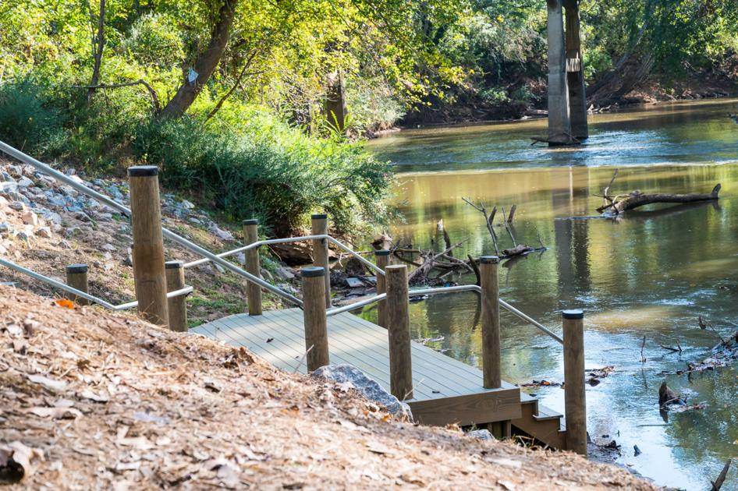
2022 ANNUAL REPORT
PRESENTED BY:
JENNA HARMON
KLCB EXECUTIVE DIRECTOR

Slide 2
Our mission at
Keep Lincoln County Beautiful is to
educate, inspire, and empower our community to improve the environment through beautification, litter prevention, and recycling.

Slide 3
2022 BEAUTIFICATION PROJECT
West Lincoln Sidewalk Project:
Planted 21 trees, 22 shrubs, and spread 10 yards of mulch
Created 3 landscape focal areas along the newly installed sidewalk
Reduced carbon dioxide levels and potentially harmful gasses from air; released oxygen
Educated students/residents of importance of trees
Teamed with Heafner’s Nursery, Lincoln Landscape, Lincoln County Schools
KLCB led the project and funded the project cost ($3,790)
Volunteers worked with West Lincoln High School’s Mr. Bridges and his students from the Agriculture and Horticulture classes.

Slide 4
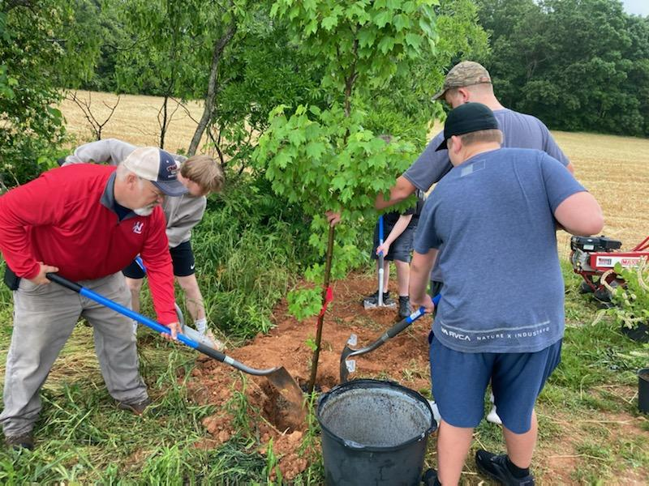
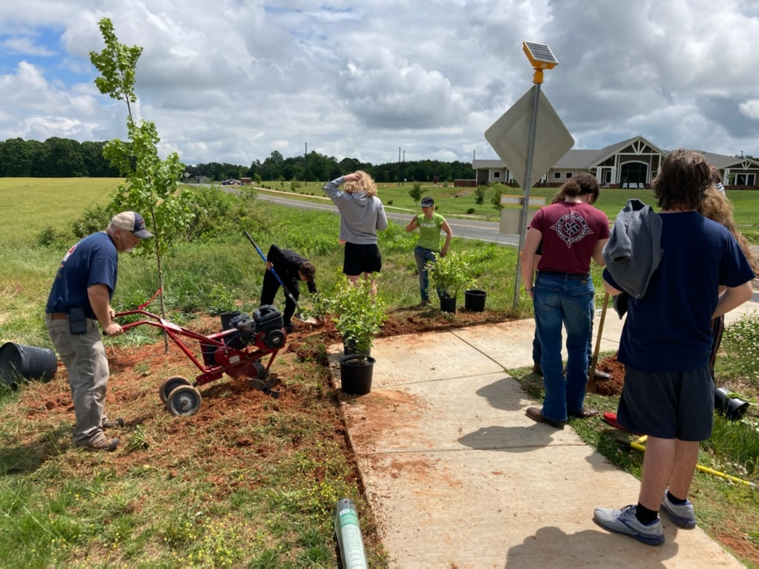
Students helped with tilling, planting, and spreading mulch. They also learned about the process to select native species and the design process for this project.

Slide 5
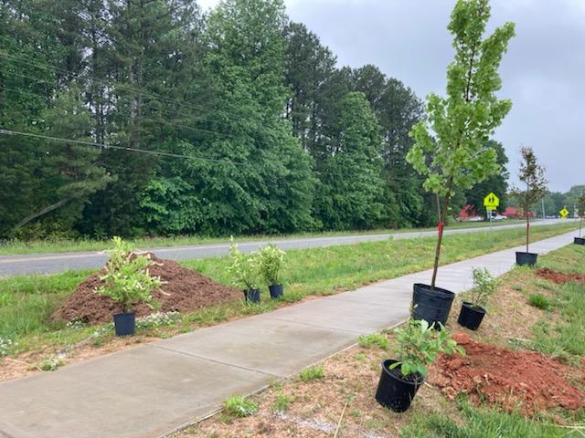
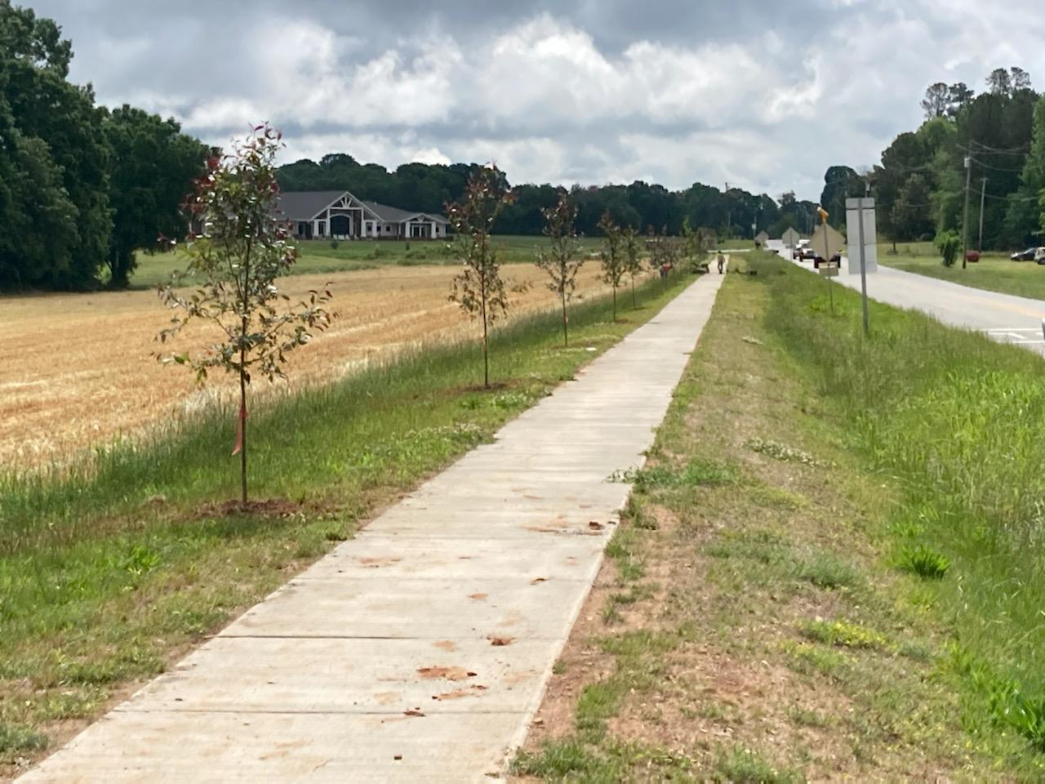
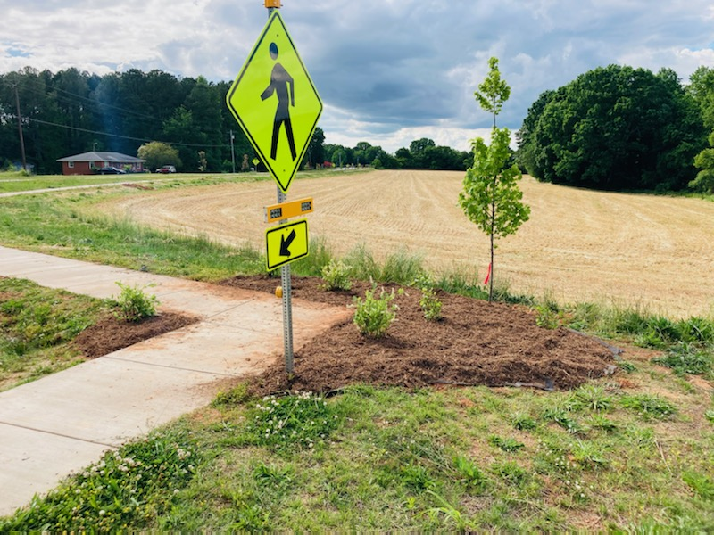
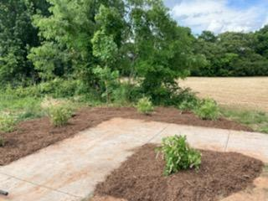
West Lincoln Sidewalk Project

Slide 6
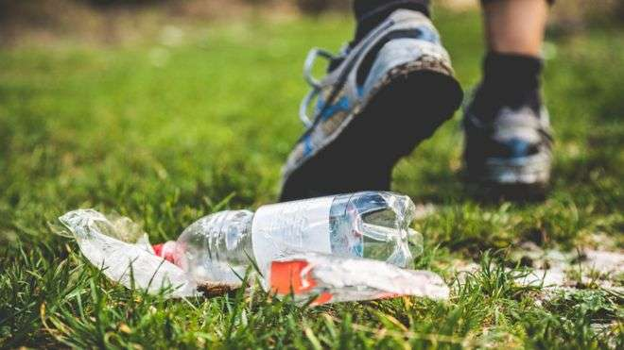
2022 LITTER ACCOMPLISHMENTS
• Roadside Litter Cleanups
• Jack Dellinger Road/Airport Road Cleanups
• South Fork River Cleanup
• Curb and Median Cleanups
• Partnerships with Other Organizations
• Rent-A-Litter Kit Program
• Free Pocket Ashtray Program

Slide 7
2022 LITTER CLEANUP TOTALS
Roadside | 837 hours | 1,411 bags
South Fork River Cleanup | 39 hours | 15 bags
Curbs/Medians | 84 hours | 238 bags
Rail Trail | 153 hours | 29 bags
TOTAL ALL CLEANUPS | 1,113 hours | 1,693 bags
Totals do not include bulk items like tires, large metal pieces, or buckets.
Homeless Camp Cleanups | 84 hours | 24.25 tons
2 different camps were cleaned with assistance from Lincoln County Sheriff’s Office, Lincoln County Grounds Department, and City of Lincolnton Police Department.

Slide 8
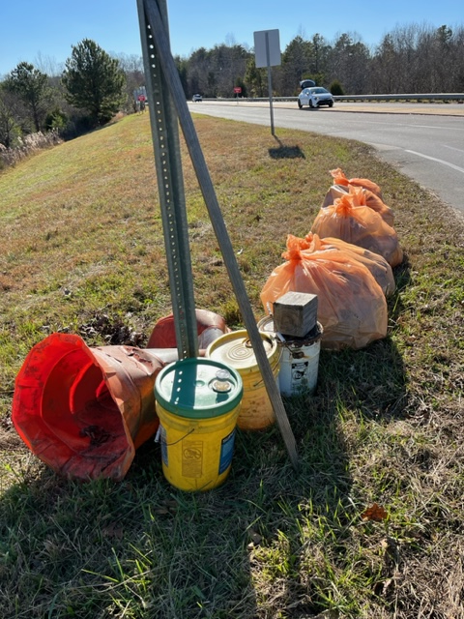
ROADSIDE LITTER TOTALS SINCE INCEPTION OF KLCB
2019
661 VOLUNTEER HOURS
1,183 BAGS COLLECTED
2020
683 VOLUNTEER HOURS
1,301 BAGS COLLECTED
2021
865 VOLUNTEER HOURS
1,566 BAGS COLLECTED
2022
837 VOLUNTEER HOURS
1,411 BAGS COLLECTED
TOTAL
3,046 VOLUNTEER HOURS
5,461 BAGS COLLECTED
Does not include bulk items such as tires, buckets, etc.

Slide 9
Roadside Litter Totals

Slide 10
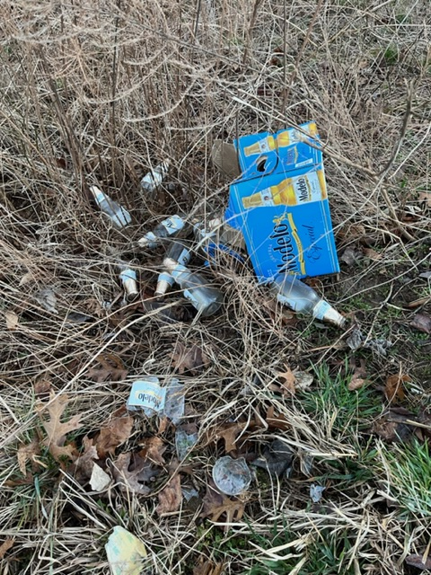
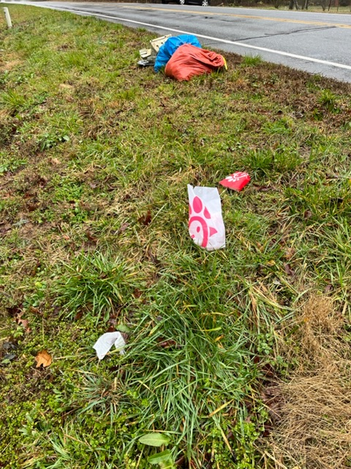
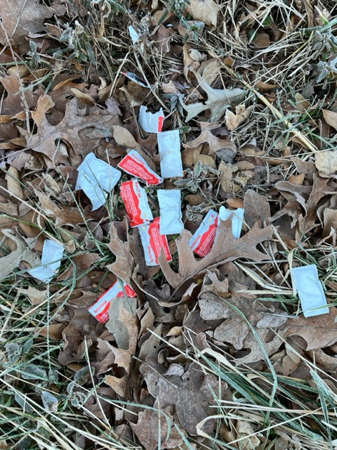
LITTER INDEX
Current Score is 2
1 (2021/2022)

Slide 11
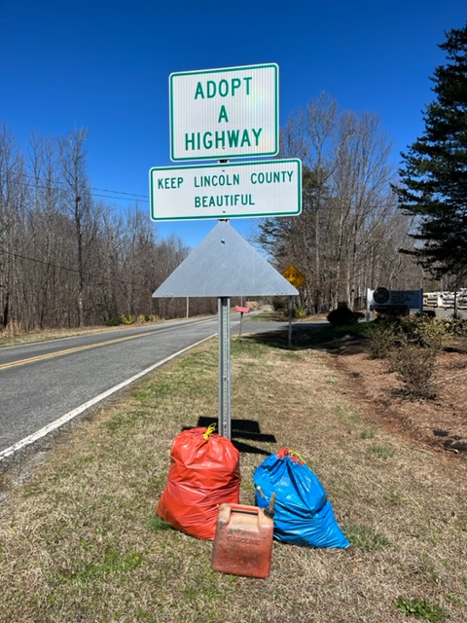
KLCB’S ADOPT-A-HIGHWAY Jack Dellinger Road /Airport Road
2022 TOTALS
6 CLEANUPS
12 VOLUNTEER HOURS
5 BAGS
MOST LITTER WAS COLLECTED NEAR THE CONVENIENCE SITE
March 2022
November 2022

Slide 12
SOUTH FORK RIVER CLEANUP
At Betty G. Ross Park
Partnered with John Davis, Lincoln County Parks & Recreation Department Director, to lead kayakers down the river and transport back to park.
Partnered with Heather & Gary Jordan, Carolina Kayaking, to provide kayaks for volunteers during event.
Partnered with Elisha Jones from Stitch Chick Embroidery to provide shirts for event attendees.
5 kayakers cleaned 4 miles of South Fork River
Removed 500 pounds of litter from the South Fork River and Betty G. Ross Park which included tires, large pieces of lumber, and bikes.

Slide 13
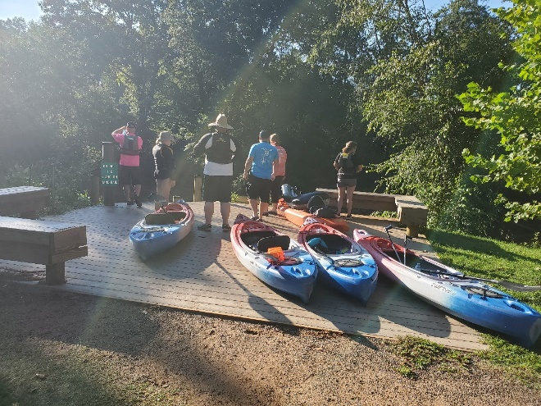
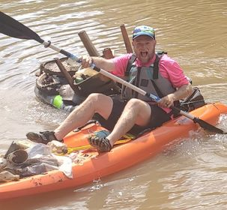
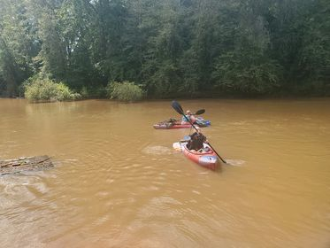
SOUTH FORK RIVER CLEANUP Betty G. Ross Park
Volunteers preparing to enter the river.
Our fearless leader, John, at the end of the trip.
Volunteers on the river.

Slide 14
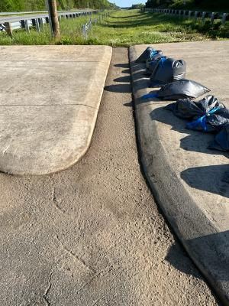
CURB AND MEDIAN CLEANUPS
Volunteers spent 84 hours collecting 238 bags of debris, which included cigarette butts, nails, and gravel. Weeds were also removed from around the medians and curbs during these cleanups.

Slide 15
PARTNERSHIPS WITH ORGANIZATIONS
NCDOT
Reported bulk items for removal from roadside
Reported traffic signs for repair
Reported road maintenance needs
Lincoln County Public Works
Reported street signs for repair, open sewer covers
Reported broken manhole covers and vent pipe
Lincoln County Sheriff’s Office, Grounds, Solid Waste
Assisted with homeless camp cleanup along South Fork River/NC-27
City of Lincolnton Police Department
Assisted with homeless camp cleanup near Food Lion/NC-27
Hesed House of Hope
Volunteers assisted with cleanup of homeless camp cleanup near Food Lion
Lincoln County Code Enforcement
Reported illegal signs on utility poles and in right-of-way

Slide 16
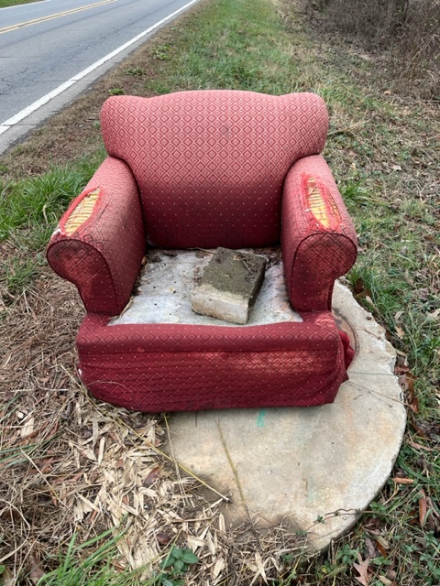
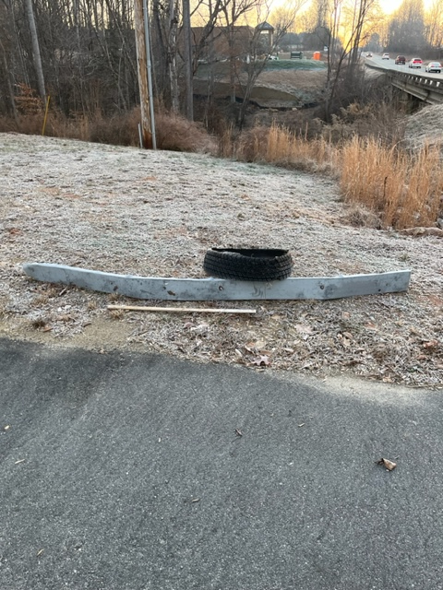
NCDOT BULK ITEMS REMOVED

Slide 17
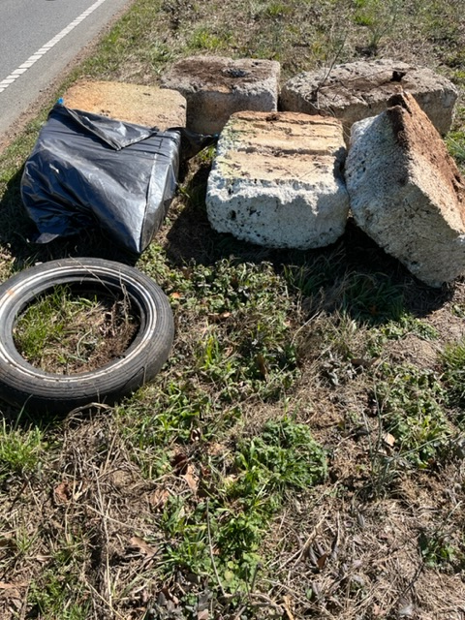
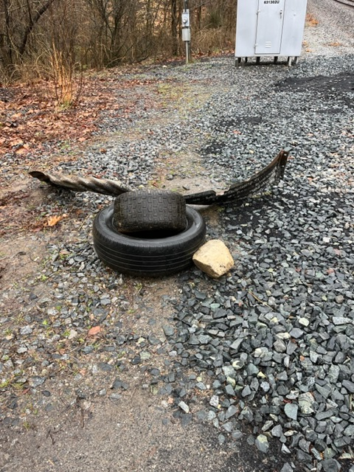
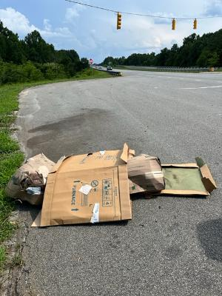
NCDOT BULK ITEMS REMOVED

Slide 18
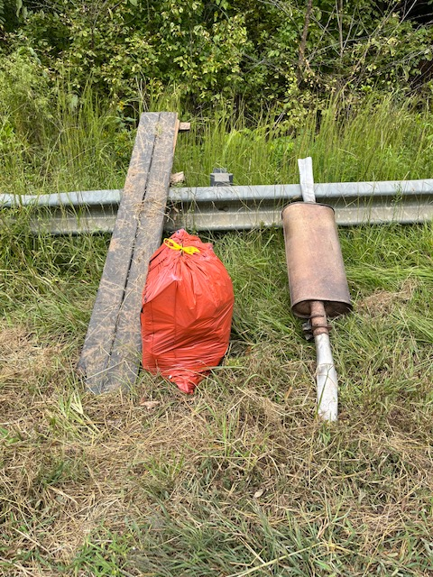
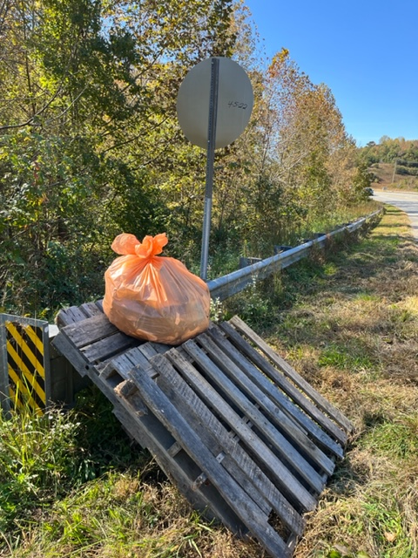
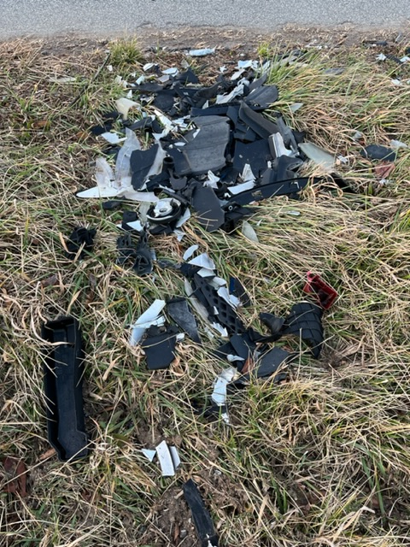
NCDOT BULK ITEMS REMOVED

Slide 19
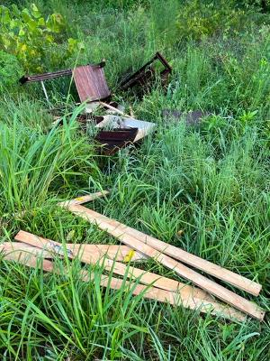
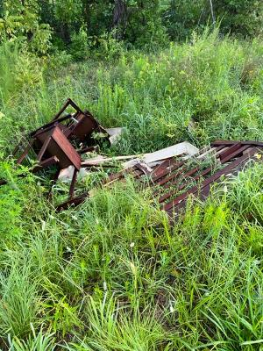
NCDOT BULK ITEMS REMOVED

Slide 20
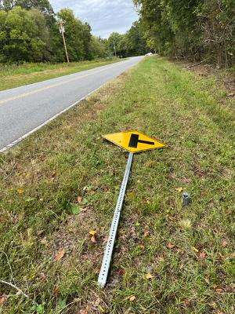
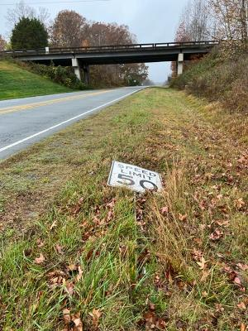
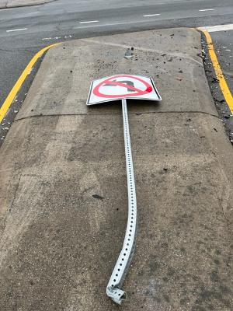
NCDOT REPAIRED TRAFFIC SIGNS

Slide 21
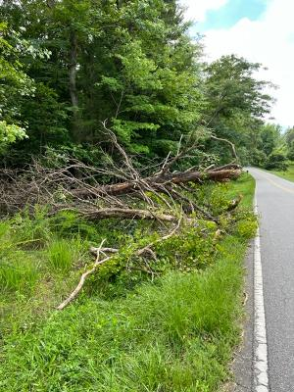
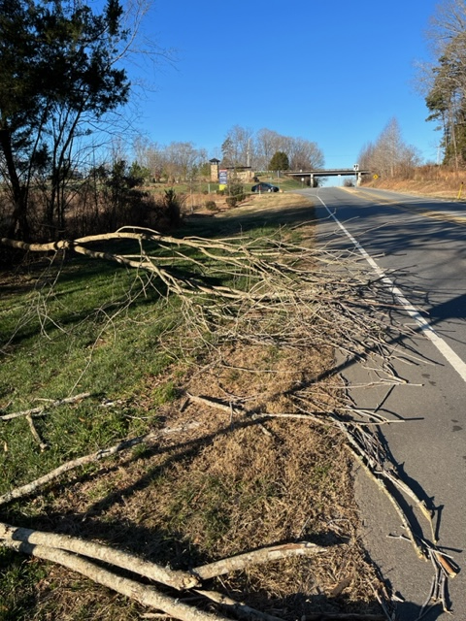
NCDOT ROAD MAINTENANCE

Slide 22
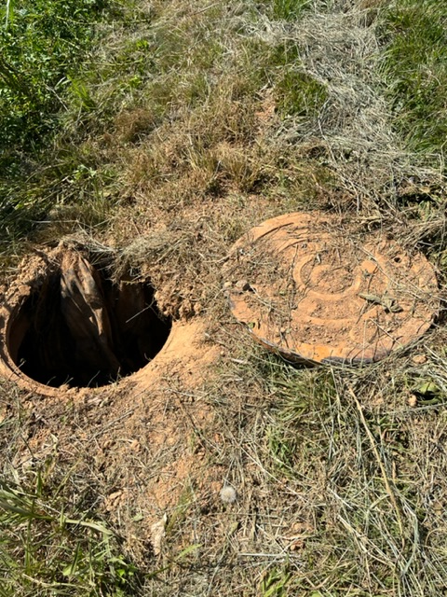
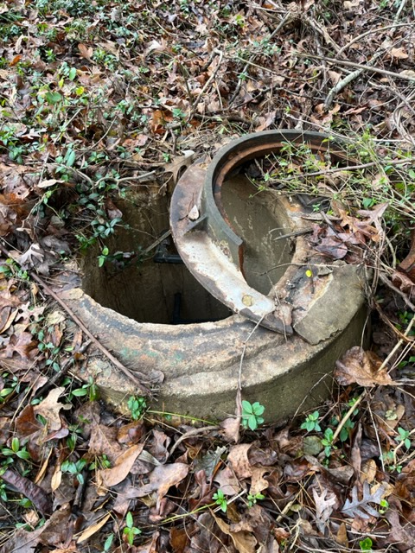
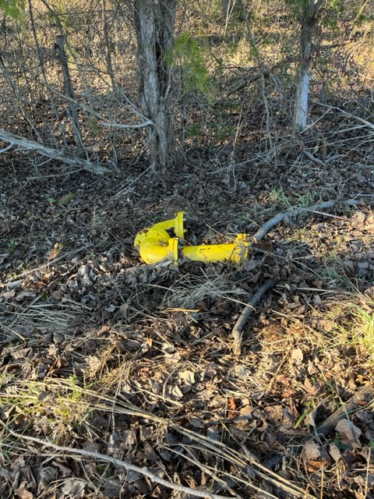
LINCOLN COUNTY PUBLIC WORKS DEPT

Slide 23
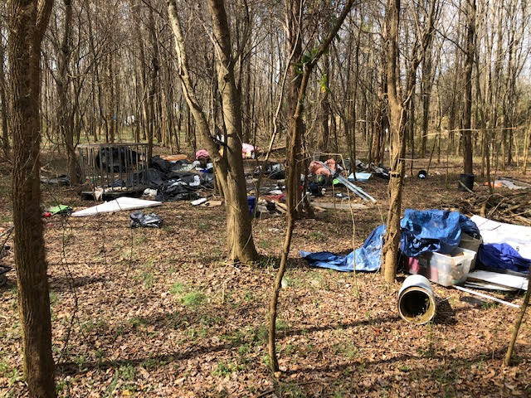
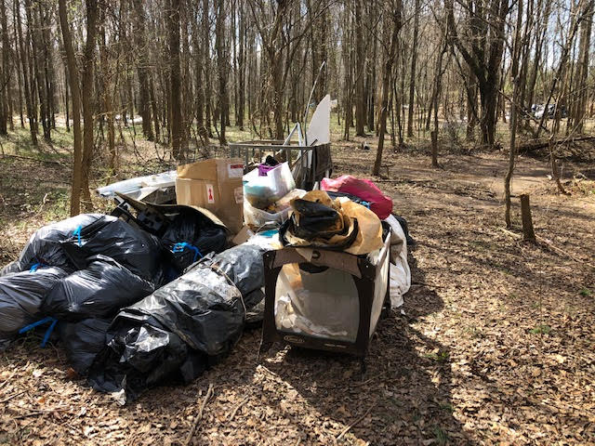
HOMELESS CAMP CLEANUP

Slide 24
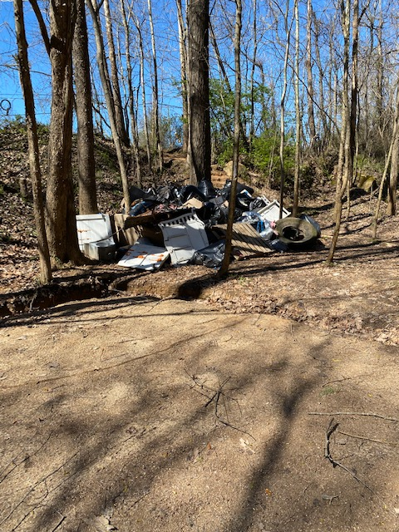
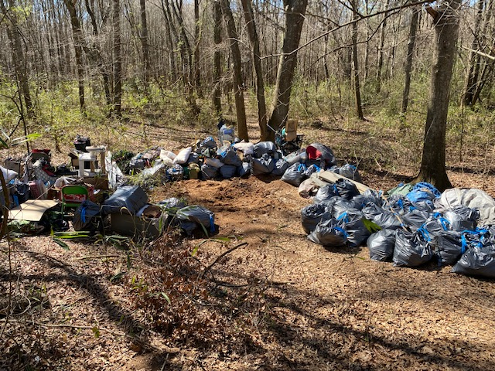
HOMELESS CAMP CLEANUP

Slide 25
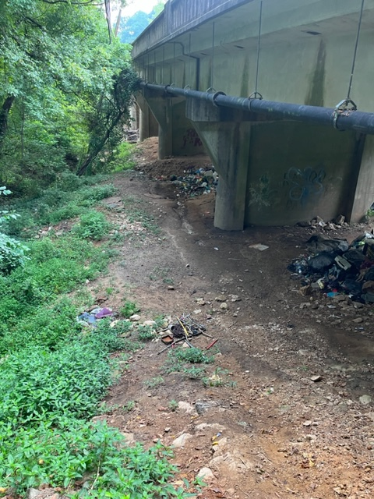
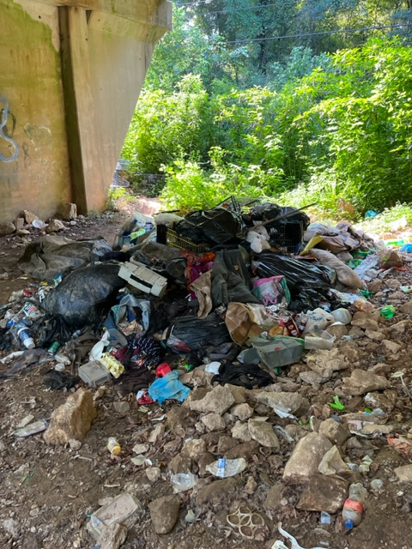
HOMELESS CAMP CLEANUP

Slide 26
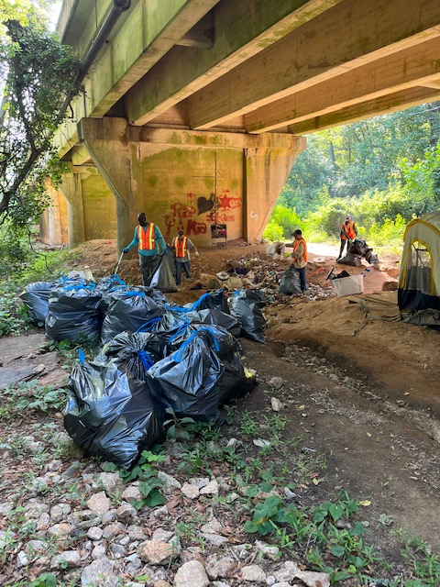
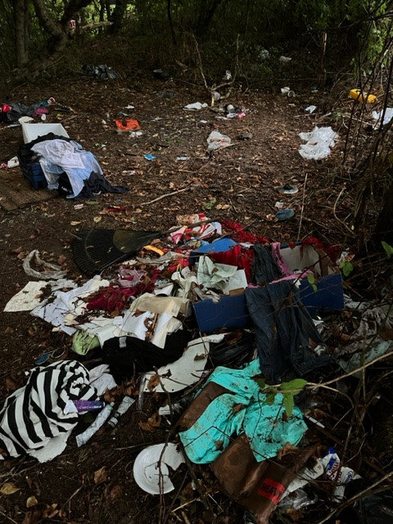
HOMELESS CAMP CLEANUP

Slide 27
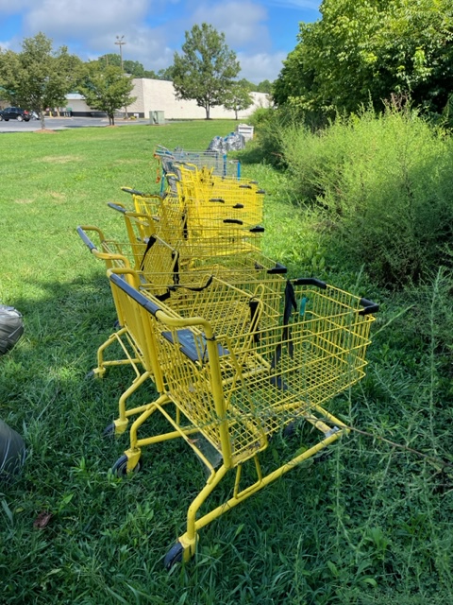
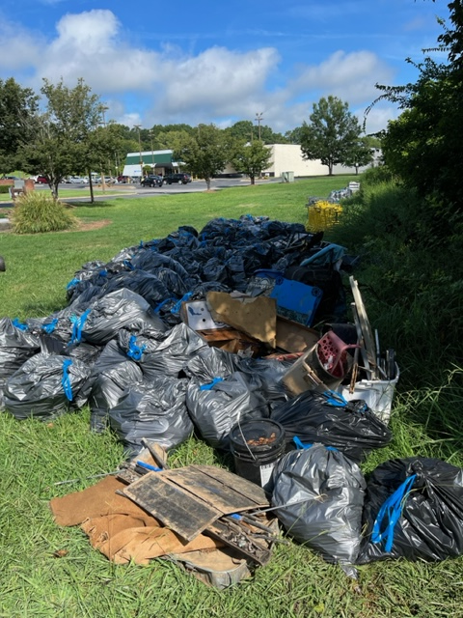
HOMELESS CAMP CLEANUP

Slide 28
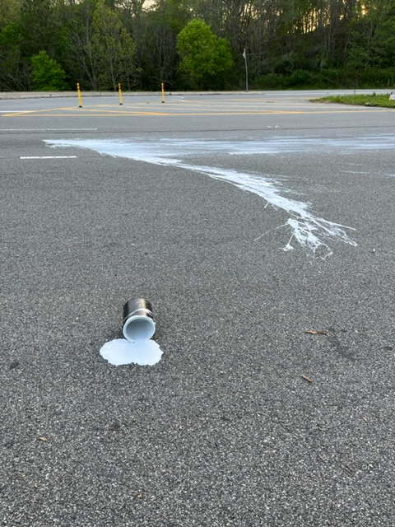
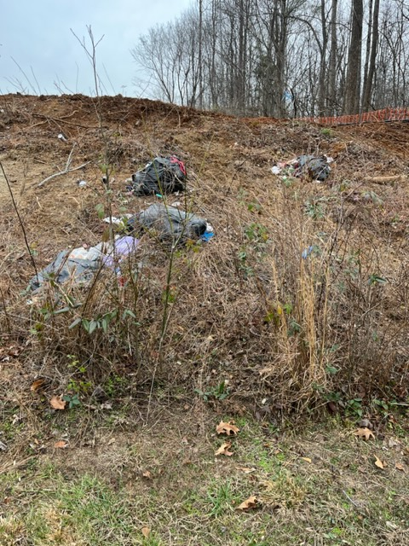
UNSECURED LOADS - A BIG CONTRIBUTOR TO LINCOLN COUNTY’S LITTER PROBLEM

Slide 29
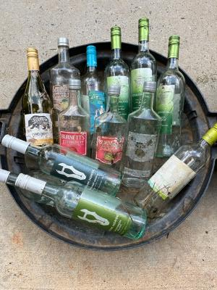
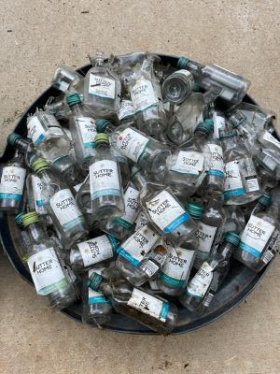
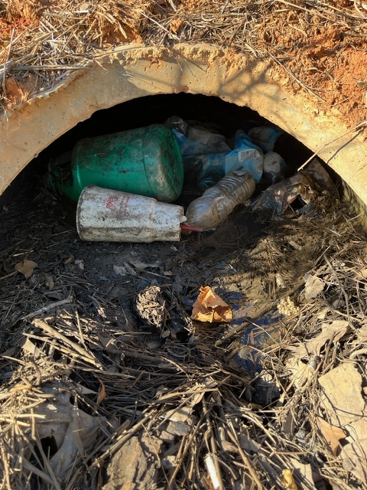
UNSECURED LOADS - A BIG CONTRIBUTOR TO LINCOLN COUNTY’S LITTER PROBLEM

Slide 30
2022 TOP ACCOMPLISHMENTS: RECYCLING
KLCB was awarded a grant in partnership with City of Lincolnton for recycling
receptacles in Downtown Lincolnton.
The receptacles were furnished by Keurig Dr. Pepper through Keep America Beautiful.

Slide 31
FUNDRAISING ACCOMPLISHMENTS
Received $10,565 in Donations
$7,500 from Lincoln County for general funding
$2,000 from City of Lincolnton for general funding
$700 from Girl Scout troop for Lincolnton Middle Tree Planting Project
$250 from private donors
$100 from donor for Lincolnton Middle Tree Planting Project
$15 from donations through AmazonSmile.com purchases
Received $260 in In-Kind Donations
5 litter pickup tools from Saine’s Hardware & Garden Center ($100 value)
4 kayak rentals from Carolina Kayaking for S. F. River Cleanup ($160 value)

Slide 32
2022 EVENT PARTICIPATION
NCDOT Spring and Fall Litter Sweeps
Chamber of Commerce Non Profit Day
National Night Out
South Fork River Cleanup
Lincoln County Apple Festival
Denver Christmas Parade

Slide 33
2022 EVENT PARTICIPATION
KLCB Tent at
Lincoln County Apple Festival
KLCB Tent at
National Night Out

Slide 34
2022 EVENT PARTICIPATION
KLCB volunteers at
Denver Christmas Parade
KLCB Litter Cleanup Team at Denver Christmas Parade

Slide 35
OTHER 2022 TOP ACCOMPLISHMENTS
Completed requirements for KAB President’s Circle to remain an affiliate in good standing and be eligible for grants and other opportunities through KAB
Maintained website and social media pages (Facebook/Instagram)
Active in other affiliate discussions to build relationships
Completed Litter Index of Lincoln County

Slide 36
2022 KLCB BOARD OF DIRECTORS
Community Board Members
Michael Stokes (Until May) - East Lincoln
Debe Howe (Effective September) – East Lincoln
Shelby Barkley - Treasurer - Central Lincoln (Until March)
Laura Gregory – Central Lincoln (Effective April)
Kyle Land - West Lincoln
Government Board Members
Josh Grant - Vice President - Lincoln County
Ritchie Haynes - City of Lincolnton (Until March)
Shelby Barkley – Treasurer – City of Lincolnton (Effective April)
Eric Eaker - Lincoln County Schools
Business/Industry Board Members
Jennifer Levin - Blum - East Lincoln
Dr. Karen Miller - Lincolnton Animal Hospital - Central Lincoln
Vacant - West Lincoln

Slide 37
OTHER ORGANIZATION INFORMATION
Executive Director
Jenna Harmon
Beautification Committee Chairperson
Josh Grant
Litter Prevention Committee Chairperson
Stefan Nicklich
Recycling Committee Co-Chairs
Jenna Harmon, Ritchie Haynes
Most Active Volunteers
Patty Korn, George Fischer

Slide 38
THANK YOU LINCOLN COUNTY FOR SUPPORTING KEEP LINCOLN COUNTY BEAUTIFUL
WWW.KLCBNC.ORG

